Slide 1
Geospatial Analysis of Cancer
Team: Gabriel Sams and Trang Hoang

Slide 2
Problem Statement
Goals:
Investigate correlations between cancer incidence rates and various factors linked to cancer
Build a dashboard to visualize the data and gather insights
Data & Methods:
6 datasets of cancer incidence for every US county
Liver and Lung cancer, each separated into general, by race, and by gender
10 datasets of factors

Slide 3
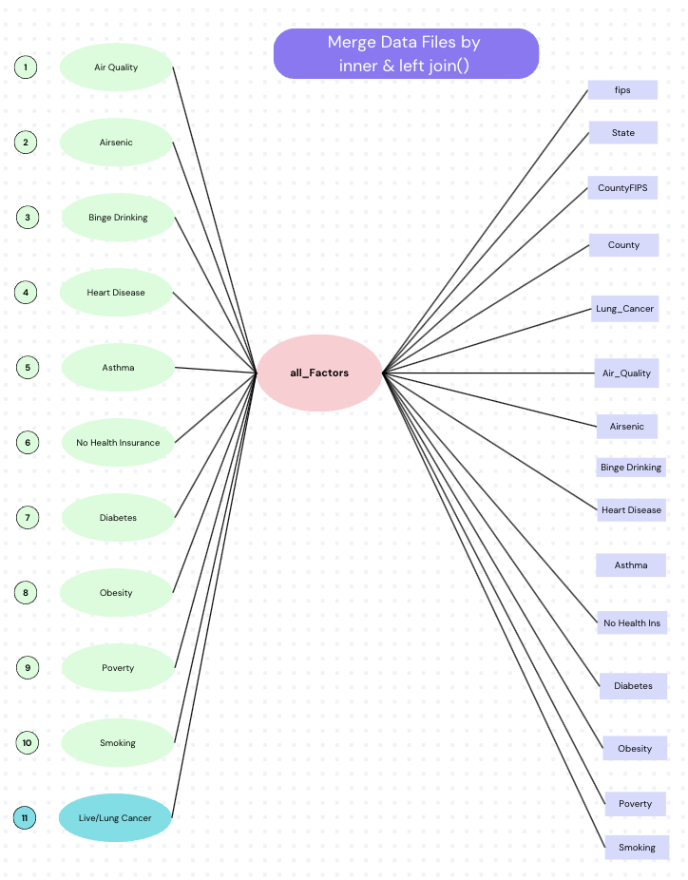
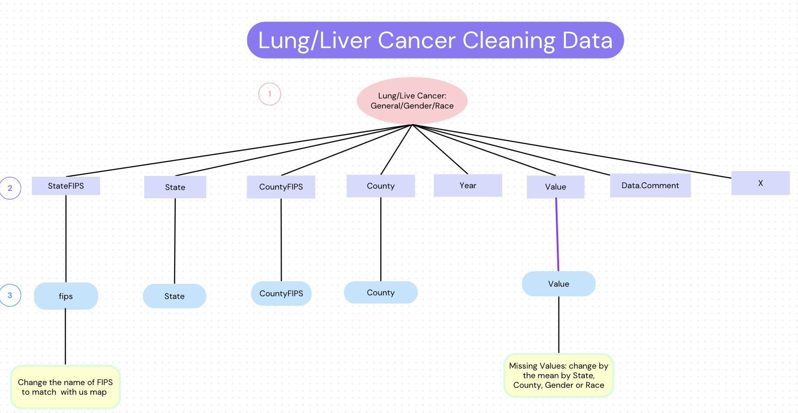
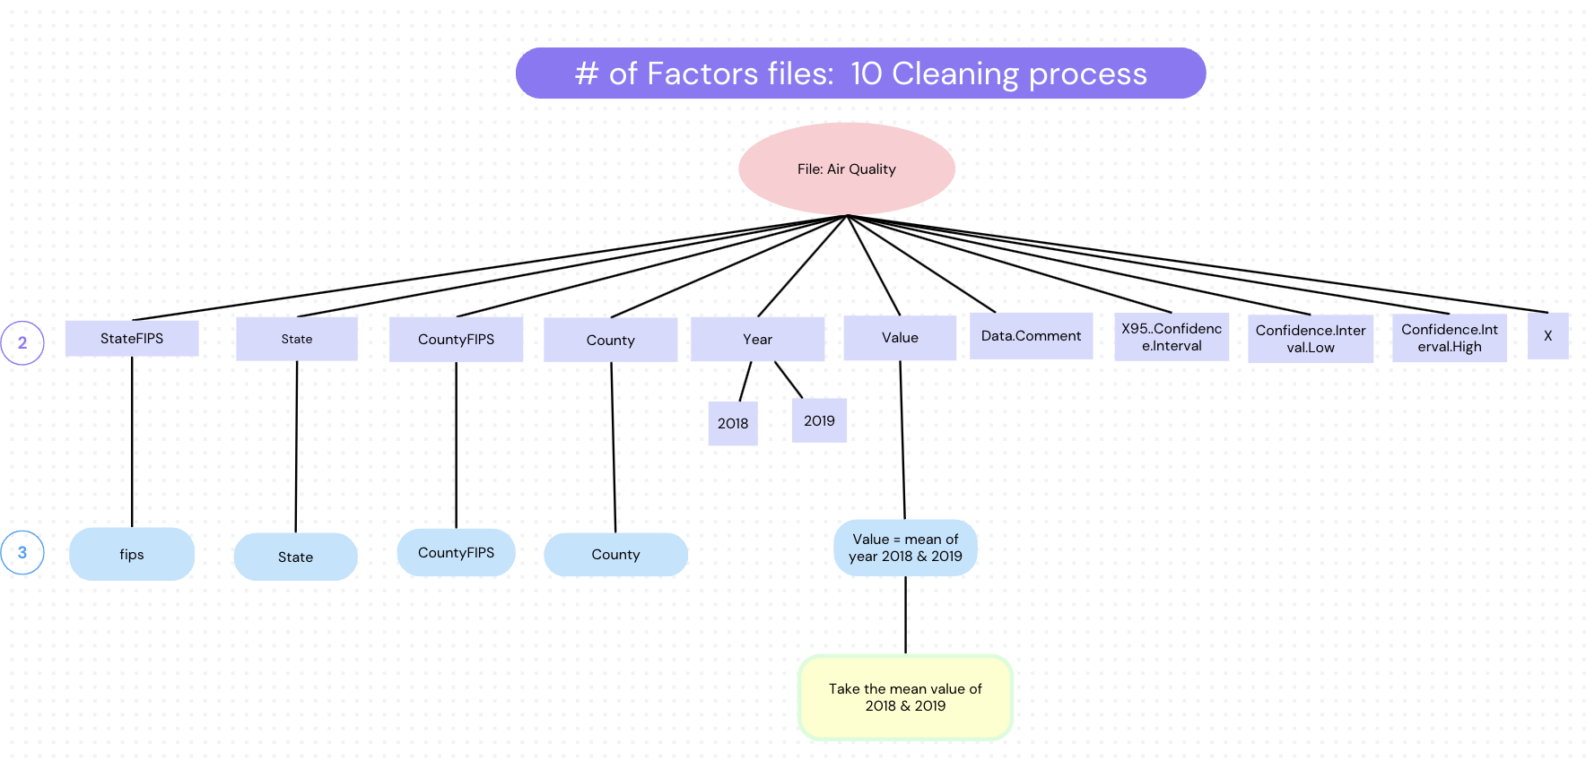
Challenges
Data wrangling:
Too many datasets, missing values and unnecessary variables
Geospatial data and time series
Non-Normalized data
Scale of exploration and inclusion on the dashboard
Complex, interactive factors
Notes:
script

Slide 4
Demo

Slide 5
Conclusion & Discussion
The factors are complex and interactive - not normalized, hard to make a comprehensive predictor for cancer.
Correlations differ between gender and race
Geospatial factor can’t be ignored
What we gained:
Flexdashboard from scratch
Data Wrangling
Correlations

Slide 6
Thank You
Question?

Slide 7
What’s on the dashboard?
(Solution Approach)

Slide 8
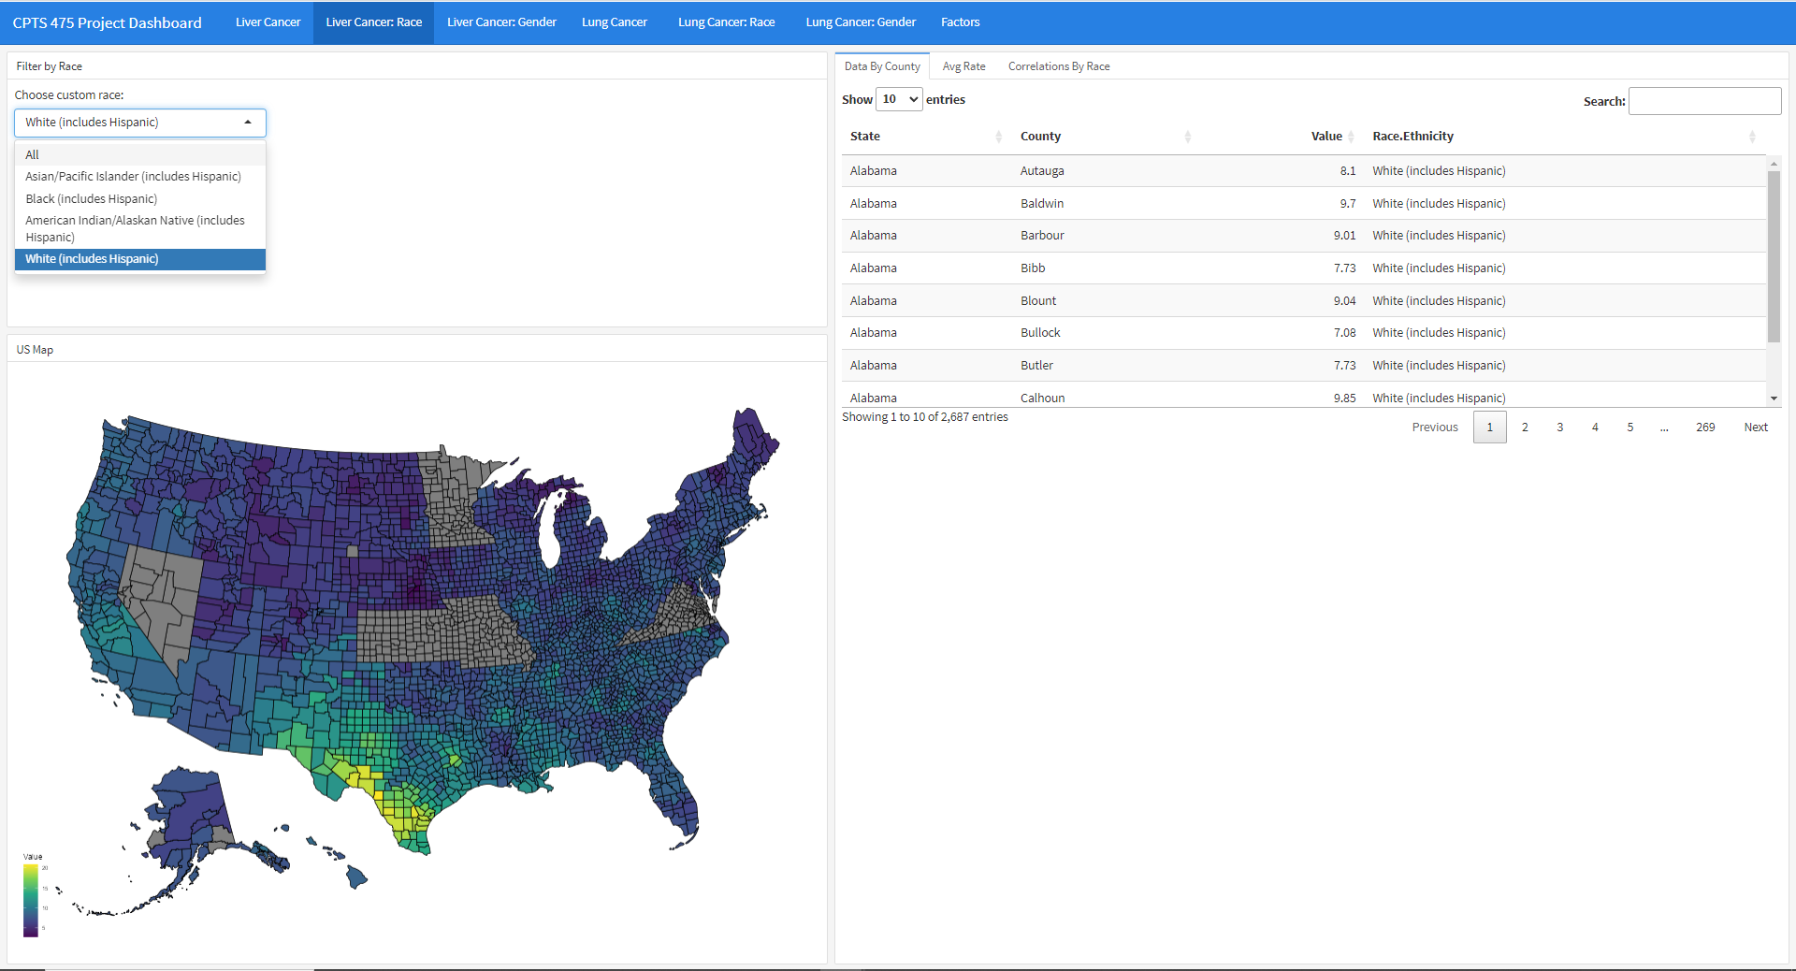
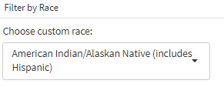

Slide 9
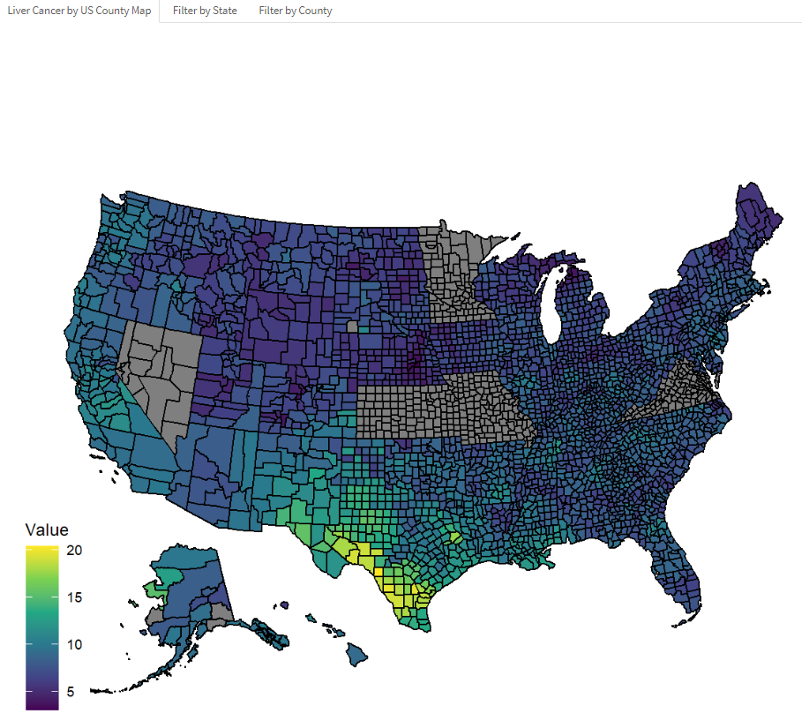
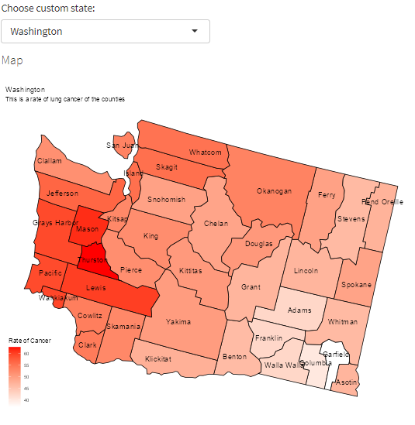
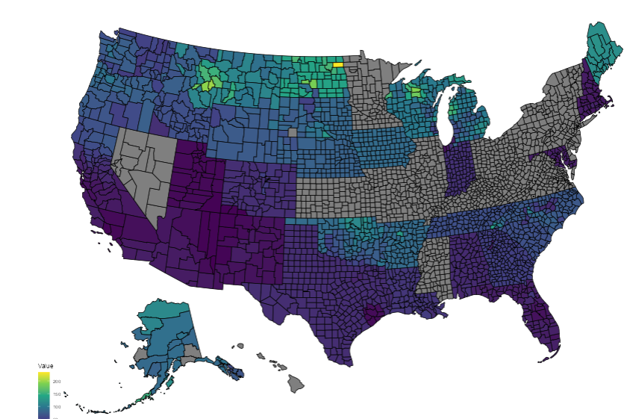
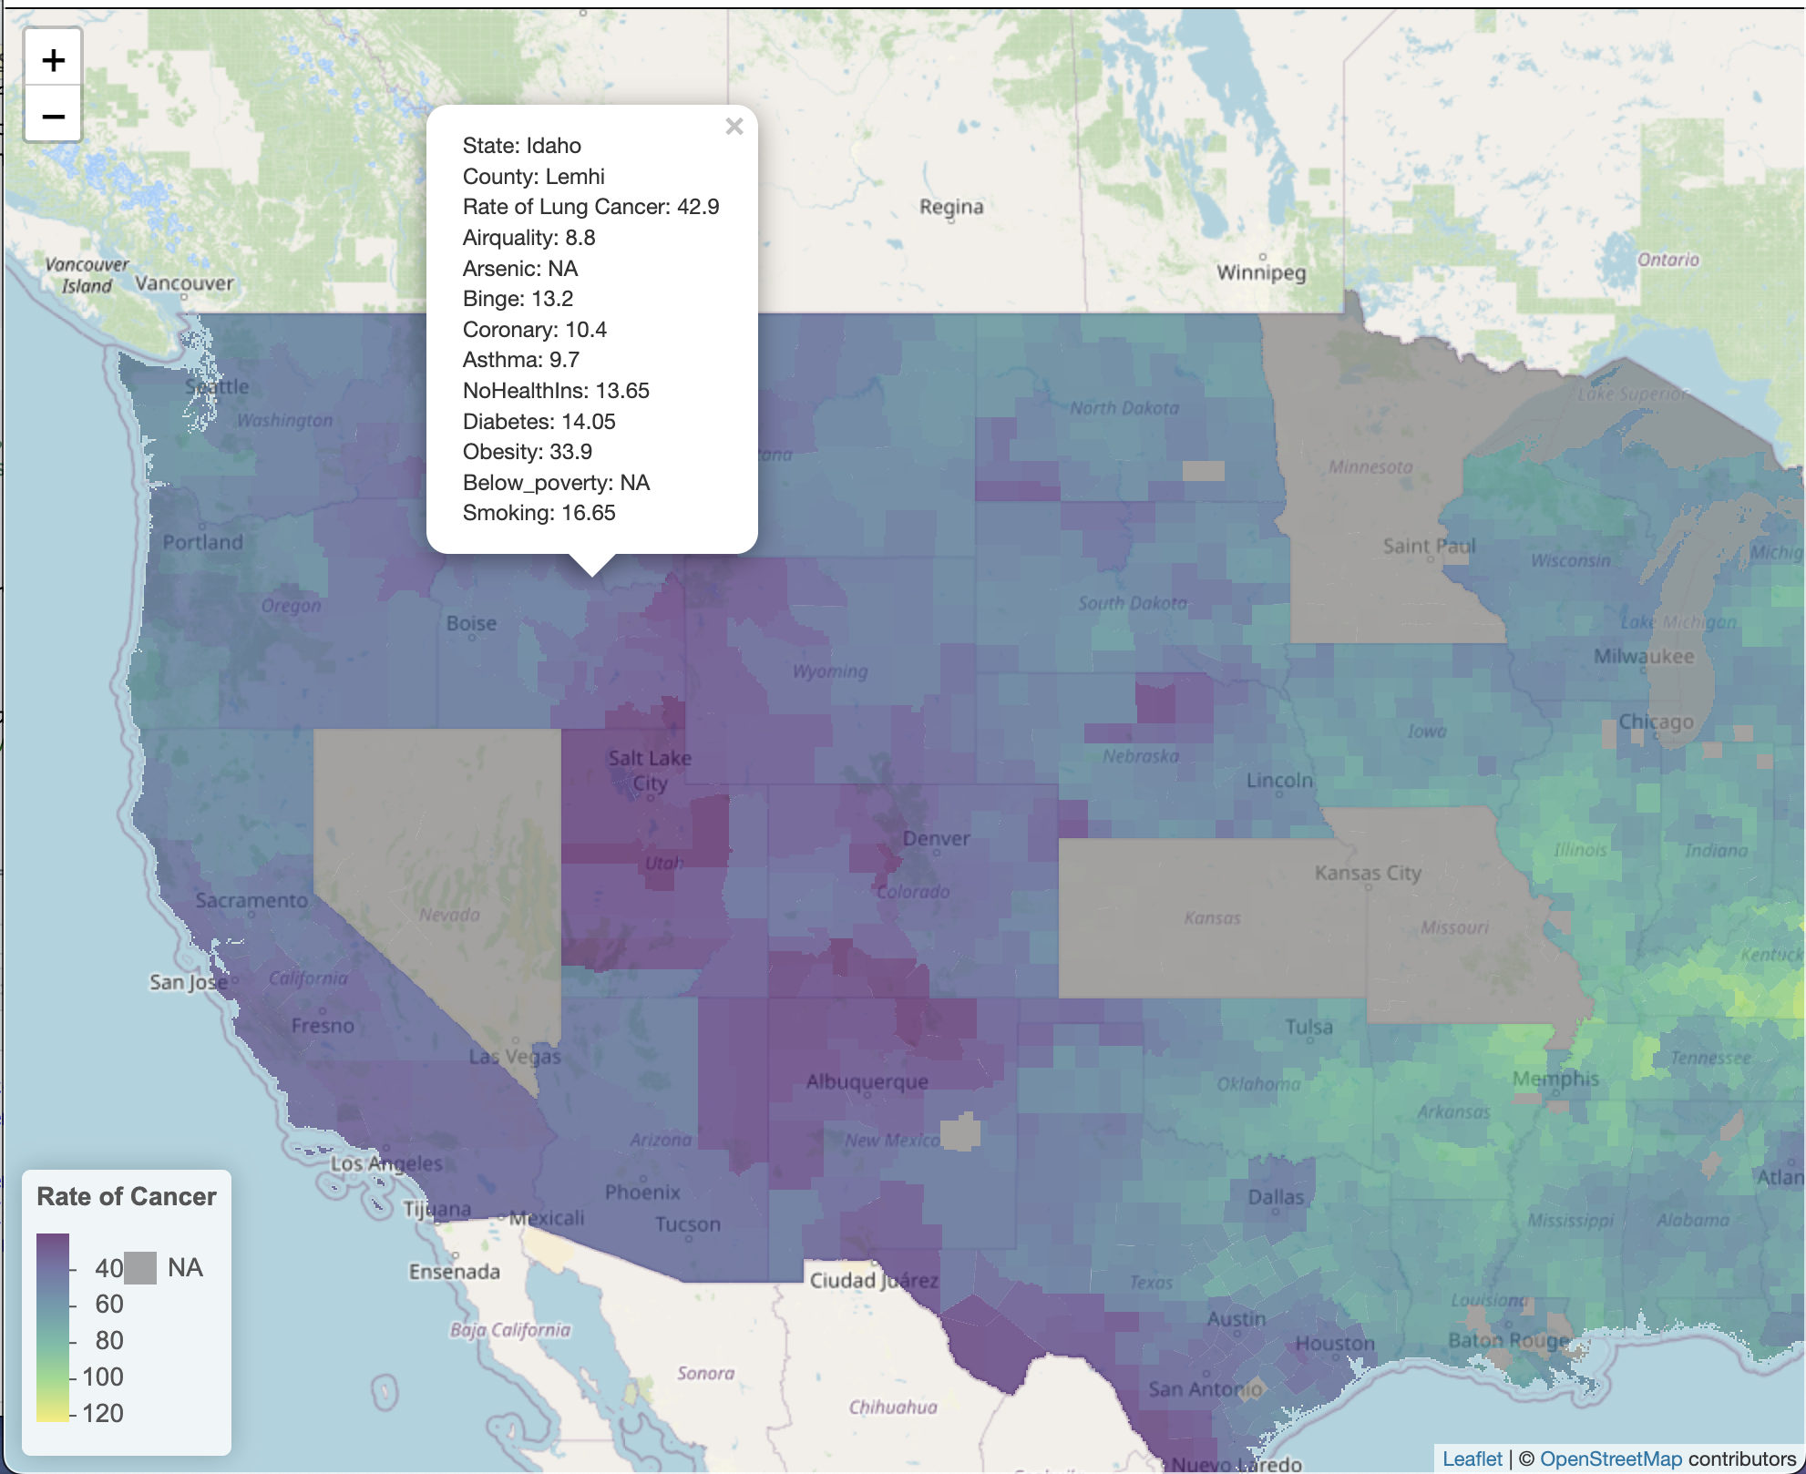
Rate of cancers filtered us map by race
Rate of cancers filtered map by state
Rate of cancers vs factors filtered map by county

Slide 10
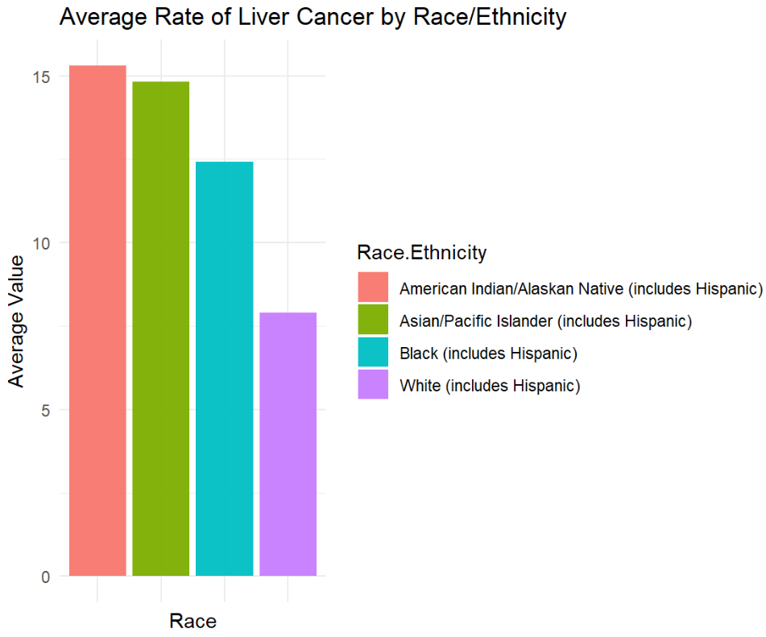
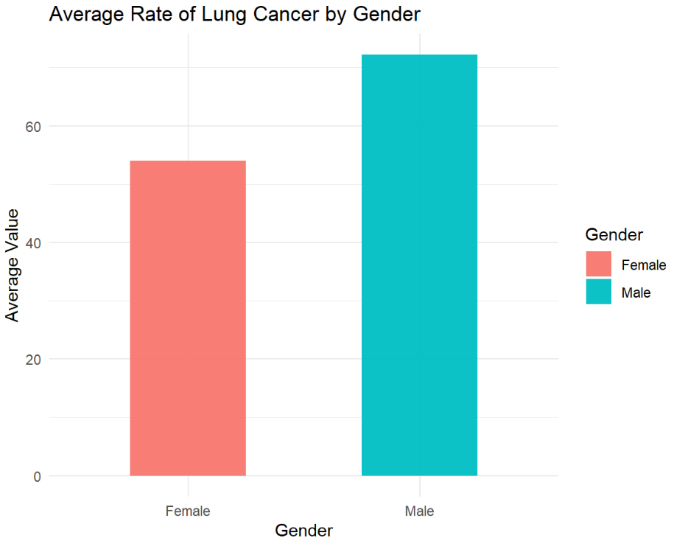
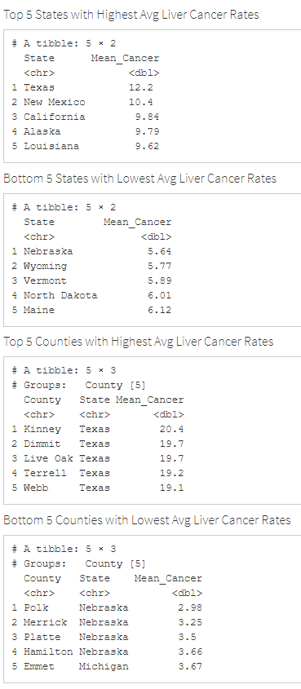
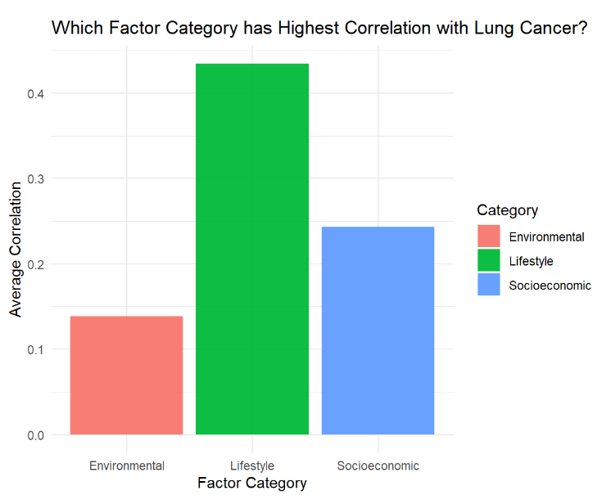
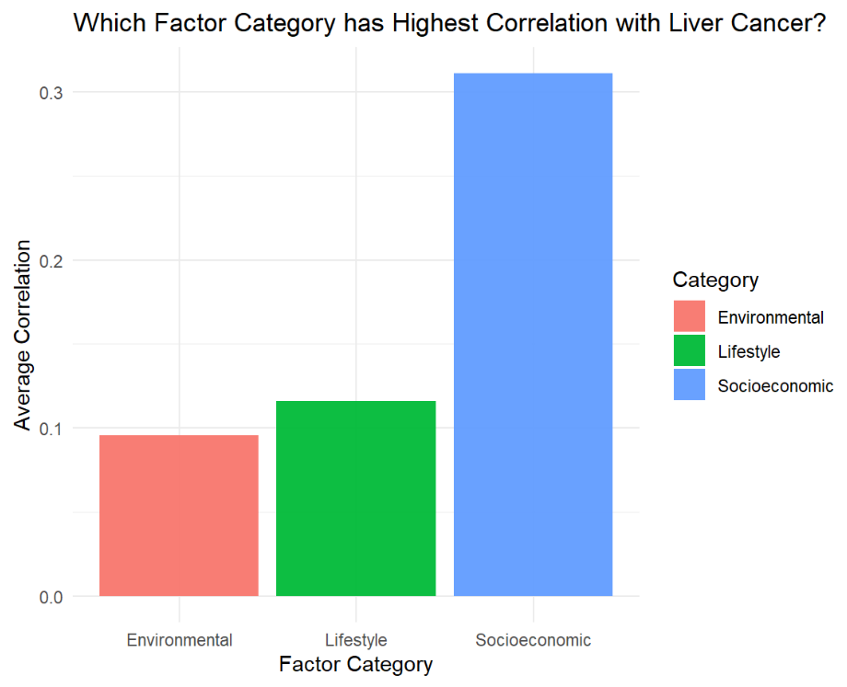

Slide 11
